Slide 1



Room Adda
Pitch Deck
Abhay Pal
Founder and CEO
+91 90842 00498

Slide 2


Room Adda
Problems and Solutions
High Cost of Student Accommodation | Current market options are often too expensive, making it difficult for students to find affordable housing.
Limited Availability of Student-Friendly Housing | Many existing platforms prioritize high-end condos, leaving a gap in affordable, student-friendly accommodation.
Hidden Fees and Complicated Booking Processes | Students often face hidden charges and complicated booking procedures, making the search for housing stressful and time-consuming.

Slide 3


Room Adda
Introduction
Our startup aims to provide affordable accommodation solutions for students by connecting them with available rooms through our user-friendly website. Property owners can register their rooms for students to view.

Slide 4

Size of the Market
average annual spending on student accommodation is assumed ₹30,000
Room Adda
350 Billion
Total Available Market (TAM):
₹350 Billion
205 Billion
Serviceable Available Market (SAM):
₹205 Billion
1 Billion
Serviceable Obtainable Market (SOM)
₹1 Billion

Slide 5


Room Adda
Direct Competitors | Indirect Competitors
OYO Life Stanza Living Nestaway | Facebook Marketplace 99acres MagicBricks
Back to Agenda Page

Slide 6
1 Affordability Our pricing model is highly cost-efficient, with listing fees significantly lower than competitors, making it accessible to budget-conscious students. | 2 User-Friendly and Scalable Platform Our website allows landlords to easily upload photos and manage listings independently, enabling rapid scalability and efficient management.
3 Dedicated Student Focus Exclusively focused on student accommodation, our platform provides tailored services and features specifically for students | 4 Flexible Pricing Plans We offer two listing plans: a small upfront fee or a higher fee only upon successful booking, catering to different property owner needs.
Room Adda

Slide 7



Room Adda
Traction
(Currently we only ad access to our local area
so traction generated is limited)
₹3000 monthly revenue
₹300 ave. revenue per customer
Back to Agenda Page

Slide 8
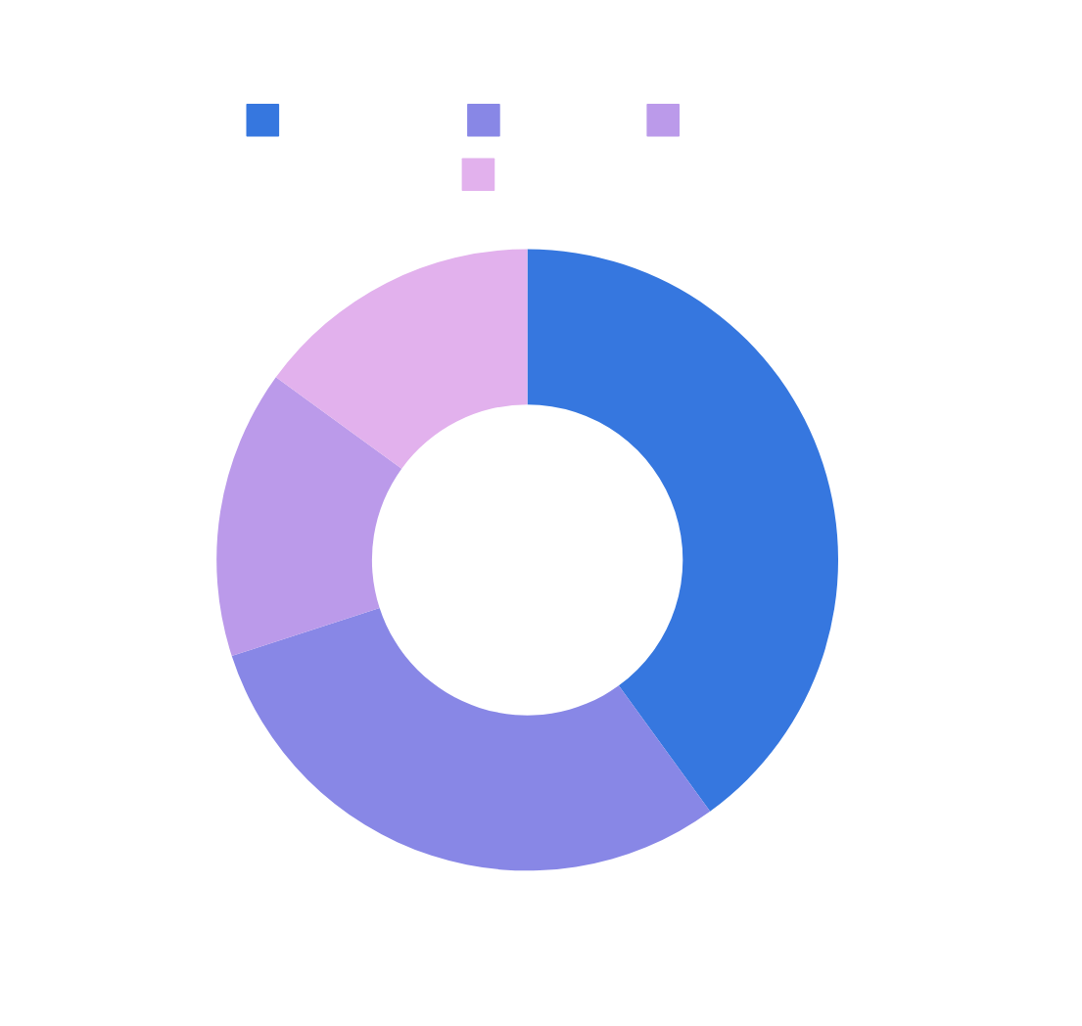


Room Adda
Use of Funds
40% on webste and applicattion development
30% on Marketing and Sales
15% on personnel
15% on Reward and refer system

Slide 9

Room Adda
Thank You

